Slide 1
Introduction to Probability and Statistics
4CM521
Continuous Probability Distributions

Slide 2
Learning Outcomes
Gain familiarity with common continuous probability distributions
Understand the characteristics, properties, and parameters associated with each distribution
Use probability density functions to calculate probabilities associated with specific intervals or events

Slide 3
Example of continuous data
Consider a study into the wing-span measurements of long eared bats
The data arising out of such a study will be continuous in nature
If we wanted to describe the sample space, it would consists of all those numbers in an interval along the Real Line; perhaps [7, 17] cm
It would not consist of a collection of discrete elements with gaps between them as was the case for discrete distribution

Slide 4
Continuous probability distributions
A consequence of this is that we have to abandon the notion of probability for each element of the sample space as was defined in the case of discrete distribution
In fact, the probability of obtaining any particular value from a continuous distribution is 0.
Instead, a continuous distribution is defined by a function known as a probability density function (p.d.f).

Slide 5
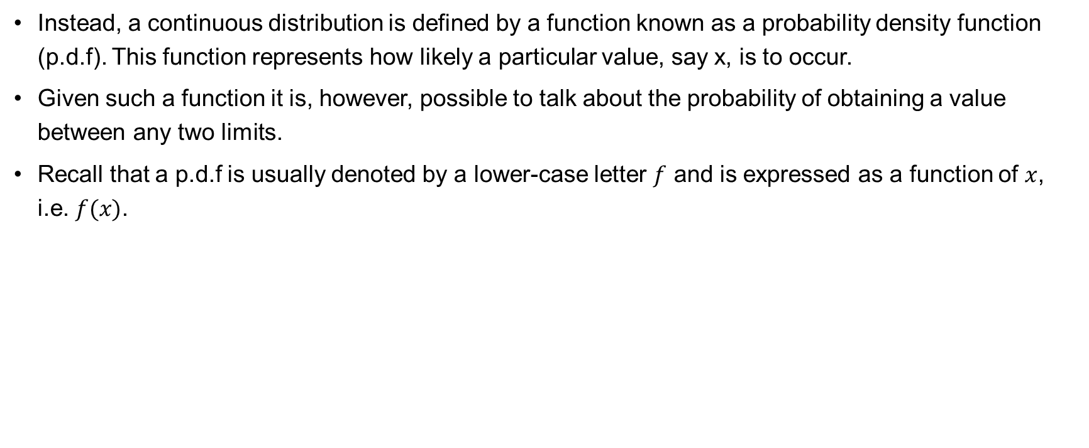
Continuous probability distributions (continued)
Instead, a continuous distribution is defined by a function known as a probability density function (p.d.f). This function represents how likely a particular value, say x, is to occur.
Given such a function it is, however, possible to talk about the probability of obtaining a value between any two limits.
Recall that a p.d.f is usually denoted by a lower-case letter $f$ and is expressed as a function of $x$, i.e. $f(x)$.

Slide 6
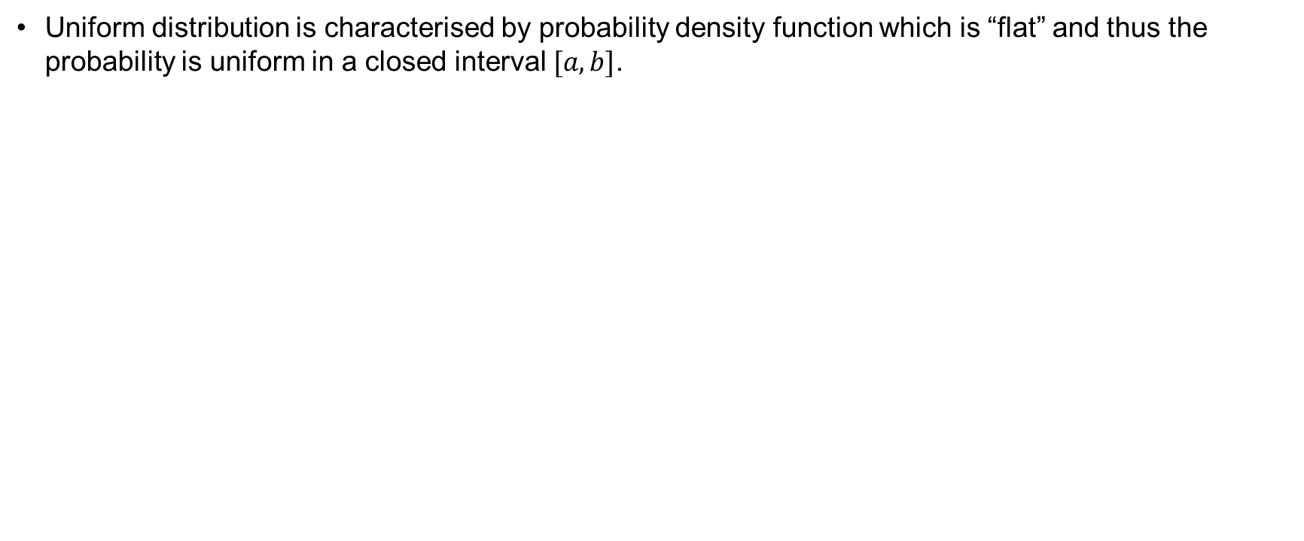
Continuous uniform distribution
Uniform distribution is characterised by probability density function which is “flat” and thus the probability is uniform in a closed interval $[a, b]$.

Slide 7
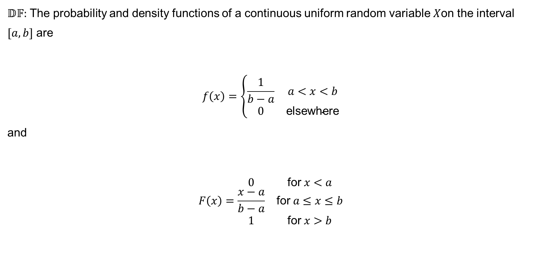
Definition of a continuous uniform distribution
$𝔻𝔽:$ The probability and density functions of a continuous uniform random variable $X$on the interval $[a, b]$ are
$$f\left(x\right)=\left\{\begin{matrix}\frac{1}{b−a} & a<x<b \\ 0 & \text{elsewhere}\end{matrix}\right.$$
and
$$F\left(x\right)=\begin{matrix}0 & \text{for} x<a \\ \frac{x−a}{b−a} & \text{for} a≤x≤b \\ 1 & \text{for} x>b\end{matrix}$$

Slide 8
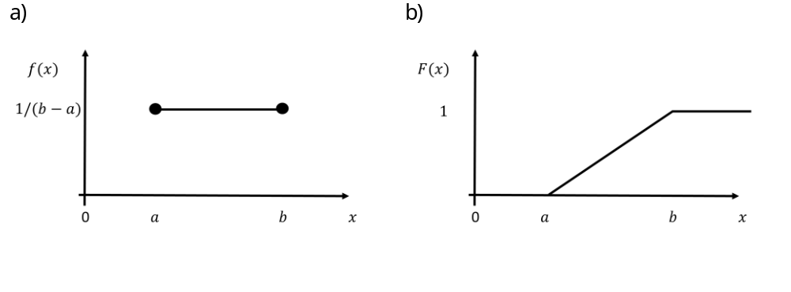
PDF and CDF of a continuous uniform distribution

Slide 9
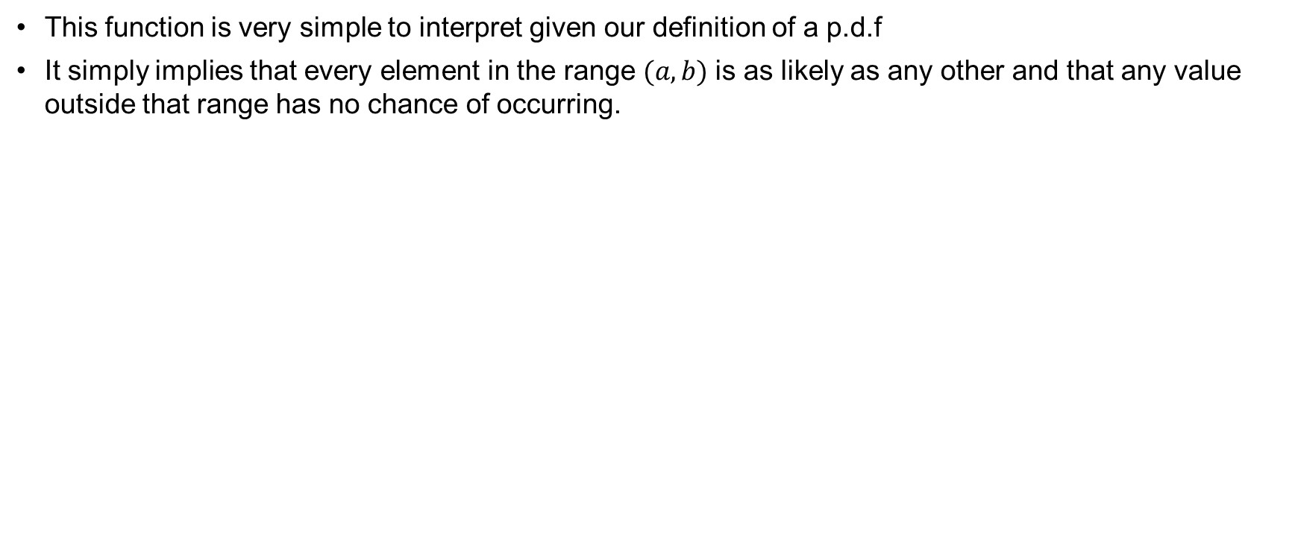
Interpretation
This function is very simple to interpret given our definition of a p.d.f
It simply implies that every element in the range $(a, b)$is as likely as any other and that any value outside that range has no chance of occurring.

Slide 10
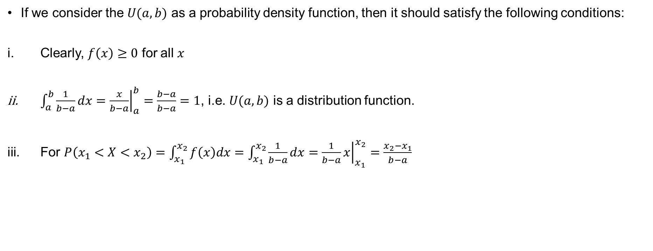
Properties
If we consider the $U(a,b)$ as a probability density function, then it should satisfy the following conditions:
Clearly, $f\left(x\right)≥0$ for all $x$
$\int_{a}^{b}{\frac{1}{b−a}dx={\left.\frac{x}{b−a}\right|}_{a}^{b}=\frac{b−a}{b−a}=1}$, i.e. $U(a,b)$ is a distribution function.
For $P\left(x_{1}<X<x_{2}\right)=\int_{x_{1}}^{x_{2}}{f\left(x\right)dx}=\int_{x_{1}}^{x_{2}}{\frac{1}{b−a}dx={\left.\frac{1}{b−a}x\right|}_{x_{1}}^{x_{2}}=\frac{x_{2}−x_{1}}{b−a}}$

Slide 11
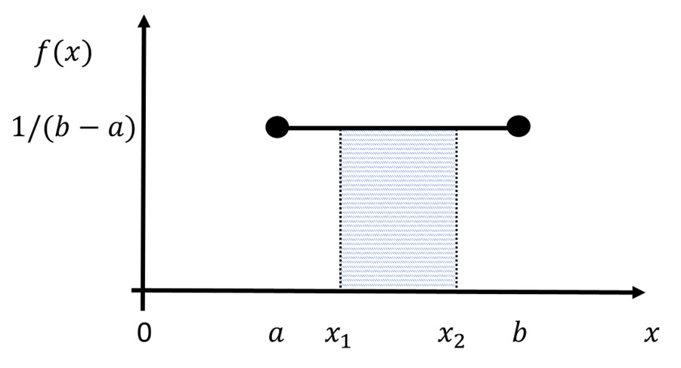
Continuous uniform distribution with boundaries

Slide 12
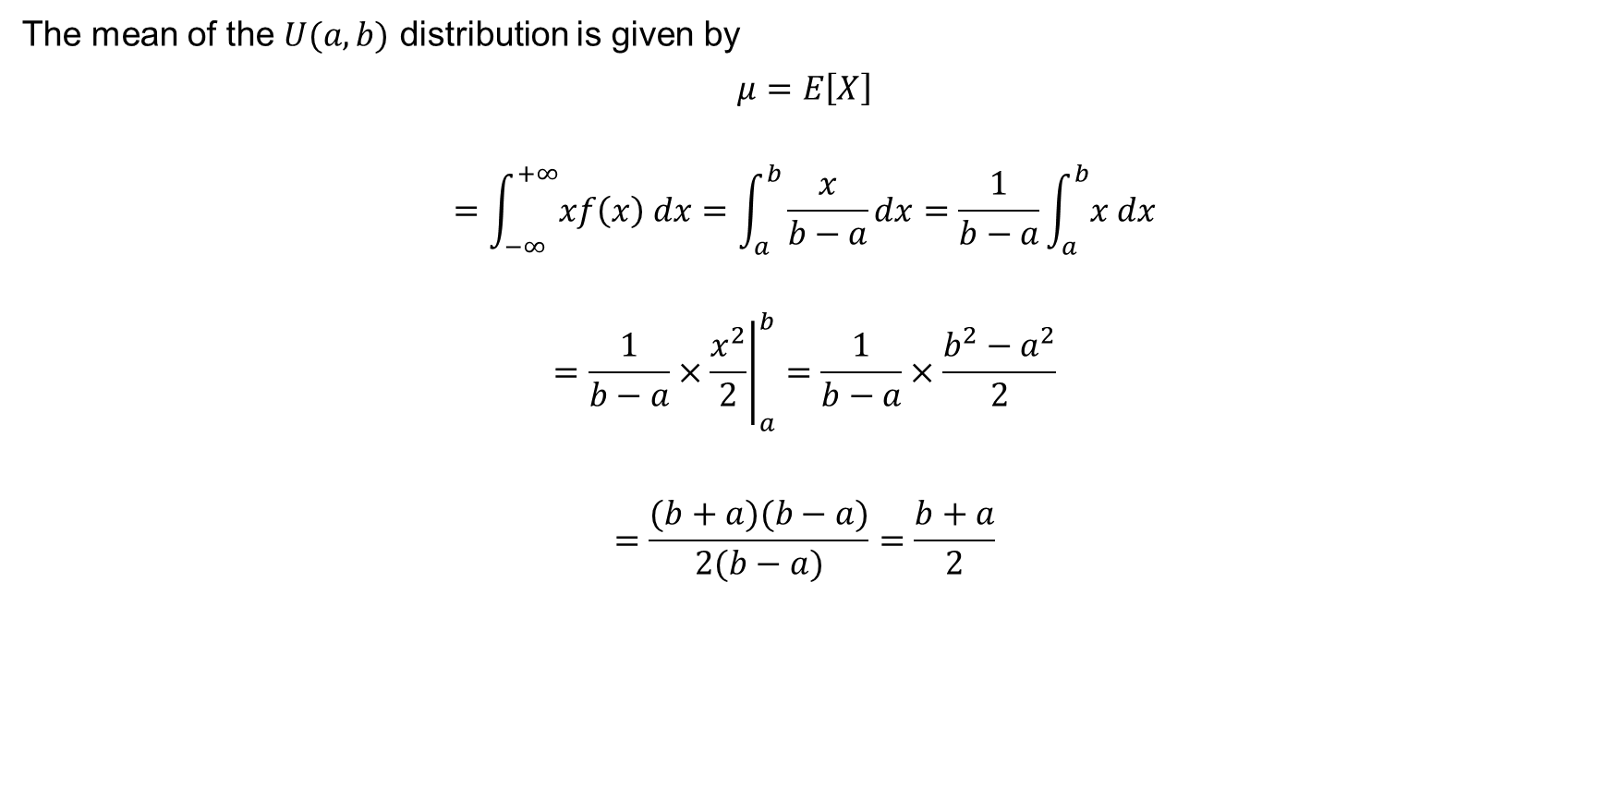

Mean for continuous uniform distribution
The mean of the $U(a,b)$ distribution is given by
$$μ=E\left[X\right]$$
$$=\int_{−∞}^{+∞}{xf\left(x\right) dx}=\int_{a}^{b}{\frac{x}{b−a}dx}=\frac{1}{b−a}\int_{a}^{b}{x dx}$$
$$={\left.\frac{1}{b−a}×\frac{x^{2}}{2}\right|}_{a}^{b}=\frac{1}{b−a}×\frac{b^{2}−a^{2}}{2}$$
$$=\frac{(b+a)(b−a)}{2(b−a)}=\frac{b+a}{2}$$

Slide 13
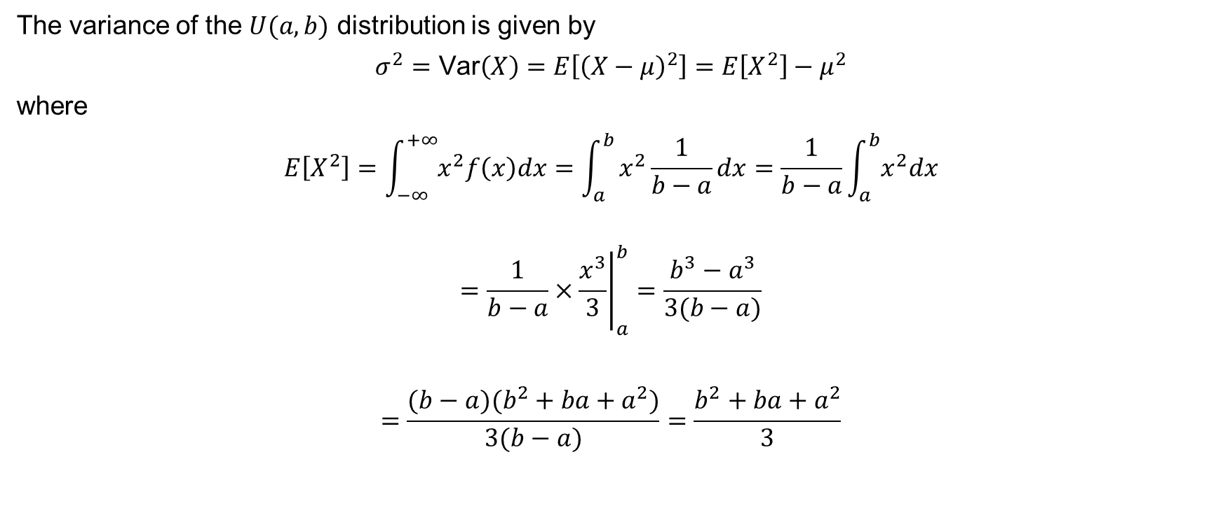

Variance for continuous uniform distribution
The variance of the $U(a,b)$ distribution is given by
$$σ^{2}=\text{Var}\left(X\right)=E\left[{\left(X−μ\right)}^{2}\right]=E\left[X^{2}\right]−μ^{2}$$
where
$$E\left[X^{2}\right]=\int_{−∞}^{+∞}{x^{2}f\left(x\right)dx}=\int_{a}^{b}{x^{2}\frac{1}{b−a}dx}=\frac{1}{b−a}\int_{a}^{b}{x^{2}dx}$$
$$={\left.\frac{1}{b−a}×\frac{x^{3}}{3}\right|}_{a}^{b}=\frac{b^{3}−a^{3}}{3(b−a)}$$
$$=\frac{(b−a)(b^{2}+ba+a^{2})}{3(b−a)}=\frac{b^{2}+ba+a^{2}}{3}$$

Slide 14
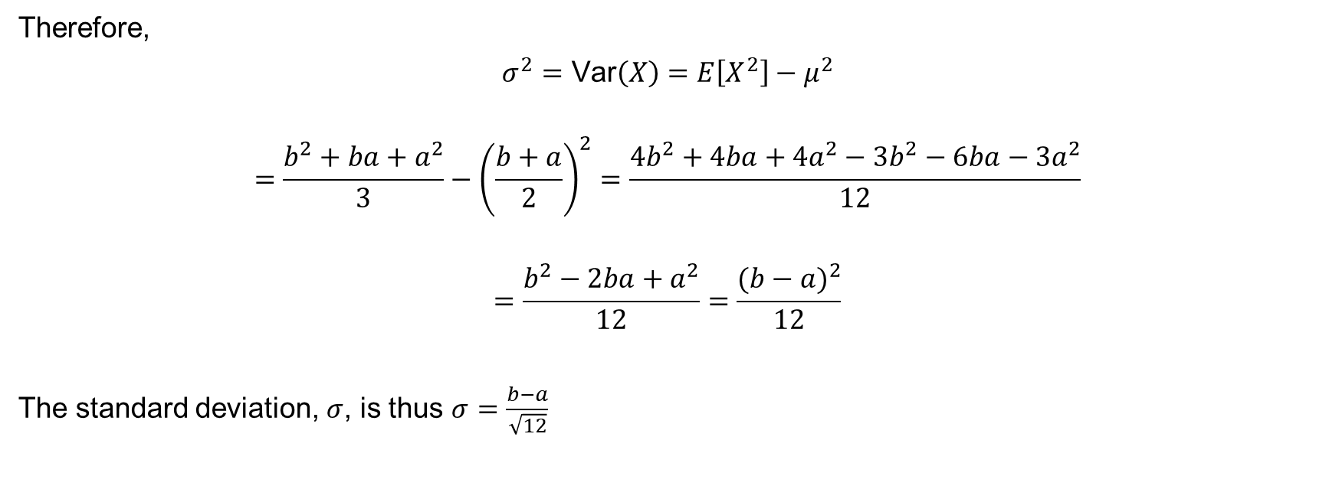



Variance for continuous uniform distribution (continued)
Therefore,
$$σ^{2}=\text{Var}\left(X\right)=E\left[X^{2}\right]−μ^{2}$$
$$=\frac{b^{2}+ba+a^{2}}{3}−{\left(\frac{b+a}{2}\right)}^{2}=\frac{4b^{2}+4ba+4a^{2}−3b^{2}−6ba−3a^{2}}{12}$$
$$=\frac{b^{2}−2ba+a^{2}}{12}=\frac{{(b−a)}^{2}}{12}$$
The standard deviation, $σ$, is thus $σ=\frac{b−a}{\sqrt{12}}$

Slide 15
Example 8.1
Let us say the waiting time at a bus stop is uniformly distributed between 1 and 12 minutes.
This means that the probability of waiting for any given amount of time between 1 and 12 minutes is the same.
For instance, the probability of waiting for exactly 5 minutes is the same as the probability of waiting for exactly 10 minutes.
Similarly, the probability of waiting for less than 5 minutes is the same as the probability of waiting for more than 5 minutes.
Showcase this using a few examples of your own.

Slide 16
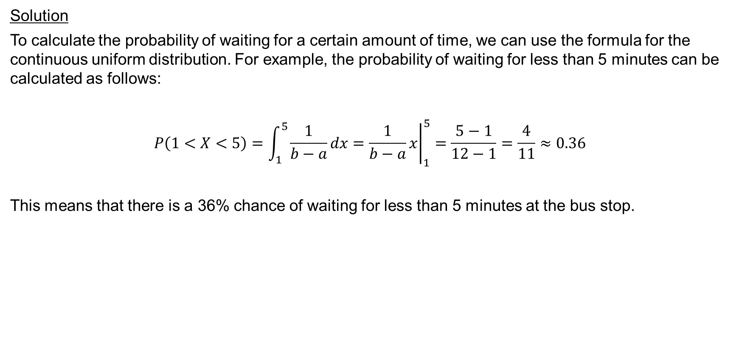
Example 8.1 (continued)
Solution
To calculate the probability of waiting for a certain amount of time, we can use the formula for the continuous uniform distribution. For example, the probability of waiting for less than 5 minutes can be calculated as follows:
$$P\left(1<X<5\right)=\int_{1}^{5}{\frac{1}{b−a}dx}={\left.\frac{1}{b−a}x\right|}_{1}^{5}=\frac{5−1}{12−1}=\frac{4}{11}≈0.36$$
This means that there is a 36% chance of waiting for less than 5 minutes at the bus stop.

Slide 17
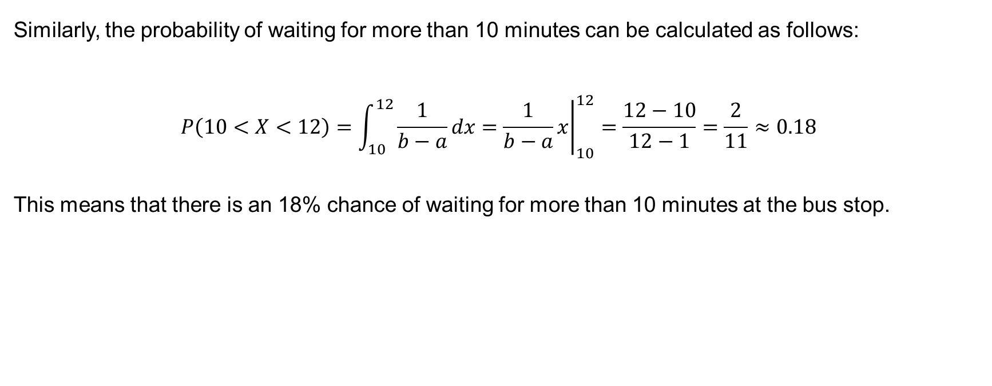
Example 8.1 (continued)
Similarly, the probability of waiting for more than 10 minutes can be calculated as follows:
$$P\left(10<X<12\right)=\int_{10}^{12}{\frac{1}{b−a}dx}={\left.\frac{1}{b−a}x\right|}_{10}^{12}=\frac{12−10}{12−1}=\frac{2}{11}≈0.18$$
This means that there is an 18% chance of waiting for more than 10 minutes at the bus stop.

Slide 18
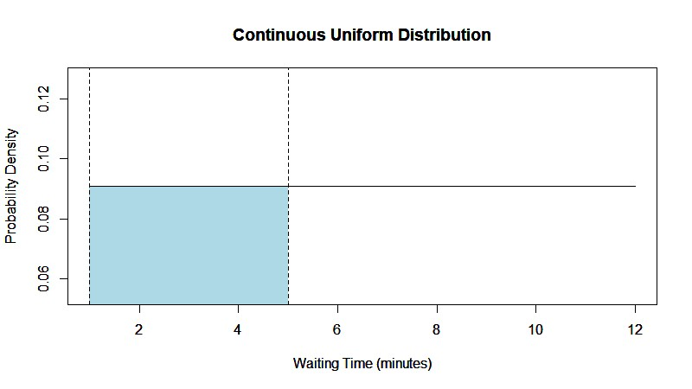

$Illustation of P\left(1<X<5\right)$

Slide 19
Exponential distribution
The exponential distribution is a probability distribution that describes the time between independent and identically distributed events occurring at a constant rate.
It is often used to model the time until the first occurrence of an event in a Poisson process.

Slide 20
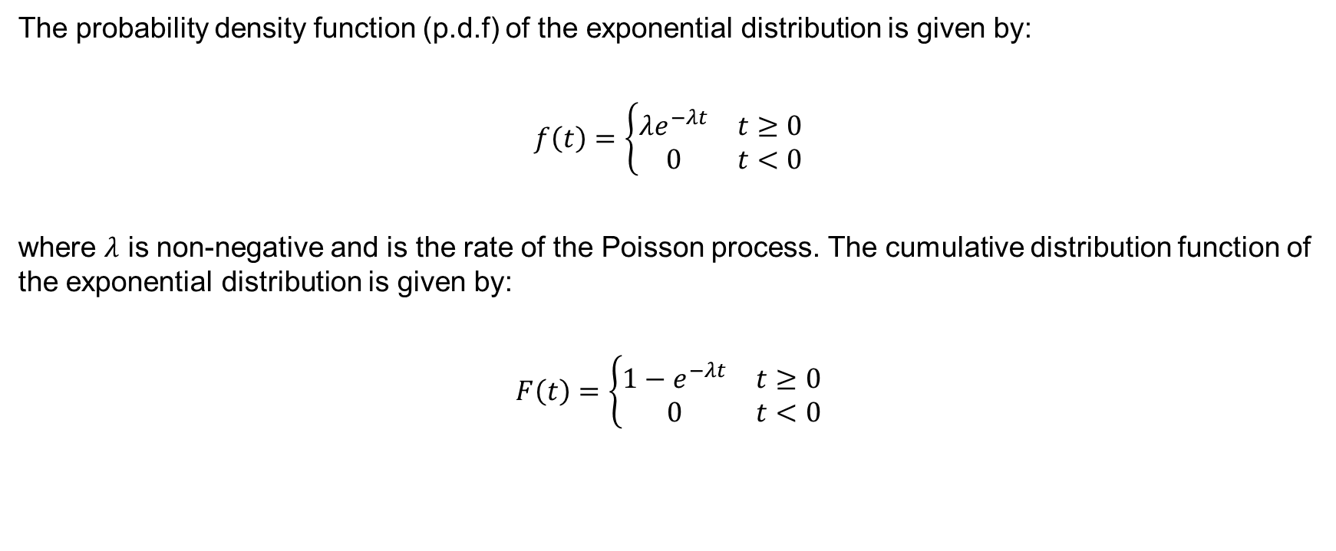
Definition of an exponential distribution
The probability density function (p.d.f) of the exponential distribution is given by:
$$f\left(t\right)=\left\{\begin{matrix}λe^{−λt} & t≥0 \\ 0 & t<0\end{matrix}\right.$$
where $λ$ is non-negative and is the rate of the Poisson process. The cumulative distribution function of the exponential distribution is given by:
$$F\left(t\right)=\left\{\begin{matrix}1−e^{−λt} & t≥0 \\ 0 & t<0\end{matrix}\right.$$

Slide 21
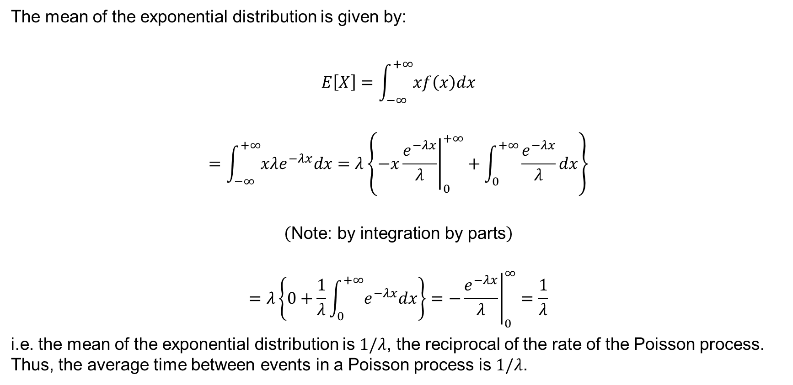
Mean for the exponential distribution
The mean of the exponential distribution is given by:
$$E\left[X\right]=\int_{−∞}^{+∞}{xf\left(x\right)dx}$$
$$=\int_{−∞}^{+∞}{xλe^{−λx}dx}=λ\left\{{\left.−x\frac{e^{−λx}}{λ}\right|}_{0}^{+∞}+\int_{0}^{+∞}{\frac{e^{−λx}}{λ}dx}\right\}$$
$$\left(\text{Note}\text{: }\text{by} \text{integration} \text{by} \text{parts}\right)$$
$$=λ\left\{0+\frac{1}{λ}\int_{0}^{+∞}{e^{−λx}dx}\right\}={\left.−\frac{ⅇ^{−λx}}{λ}\right|}_{0}^{∞}=\frac{1}{λ}$$
i.e. the mean of the exponential distribution is $1/λ$, the reciprocal of the rate of the Poisson process. Thus, the average time between events in a Poisson process is $1/λ$.

Slide 22
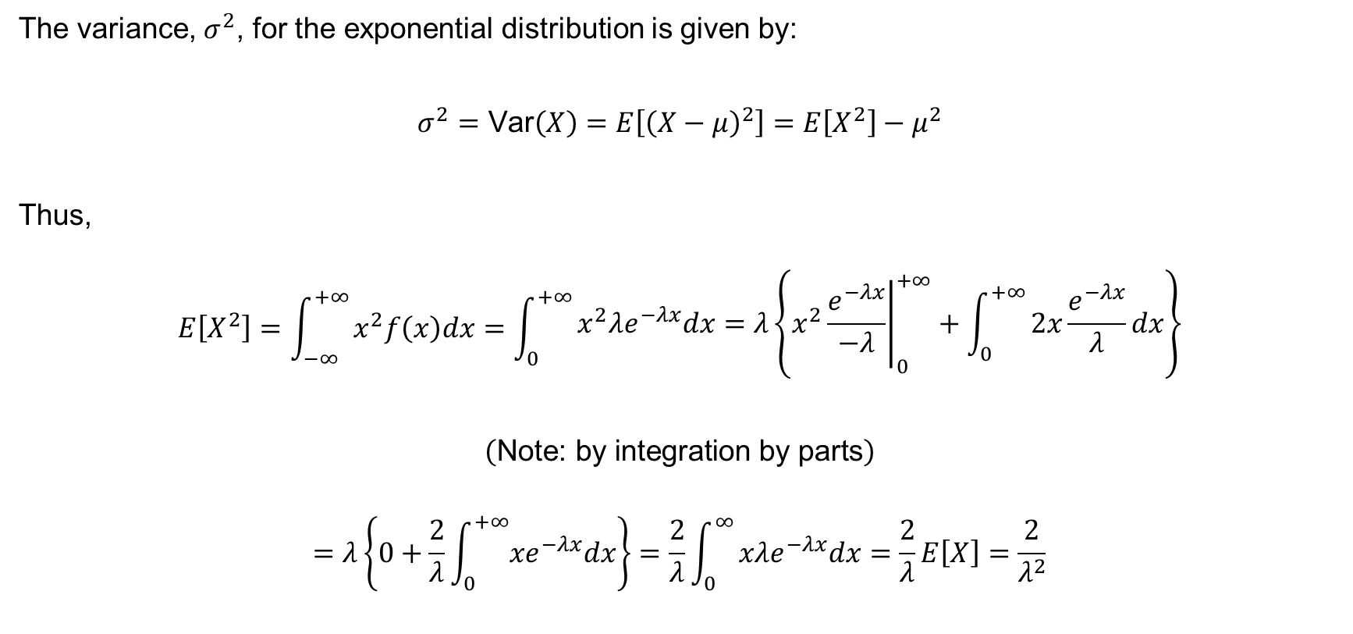
Variance for the exponential distribution
The variance, $σ^{2}$, for the exponential distribution is given by:
$$σ^{2}=\text{Var}\left(X\right)=E\left[{\left(X−μ\right)}^{2}\right]=E\left[X^{2}\right]−μ^{2}$$
Thus,
$$E\left[X^{2}\right]=\int_{−∞}^{+∞}{x^{2}f\left(x\right)dx=\int_{0}^{+∞}{\begin{aligned}x^{2}λe^{−λx}dx=λ\left\{{\left.x^{2}\frac{e^{−λx}}{−λ}\right|}_{0}^{+∞}+\int_{0}^{+∞}{2x\frac{e^{−λx}}{λ}dx}\right\} \\ \end{aligned}}}$$
$$\left(\text{Note}\text{: }\text{by} \text{integration} \text{by} \text{parts}\right)$$
$$=λ\left\{0+\frac{2}{λ}\int_{0}^{+∞}{{xe}^{−λx}dx}\right\}=\frac{2}{λ}\int_{0}^{∞}{xλe^{−λx}dx=\frac{2}{λ}E\left[X\right]=\frac{2}{λ^{2}}}$$

Slide 23
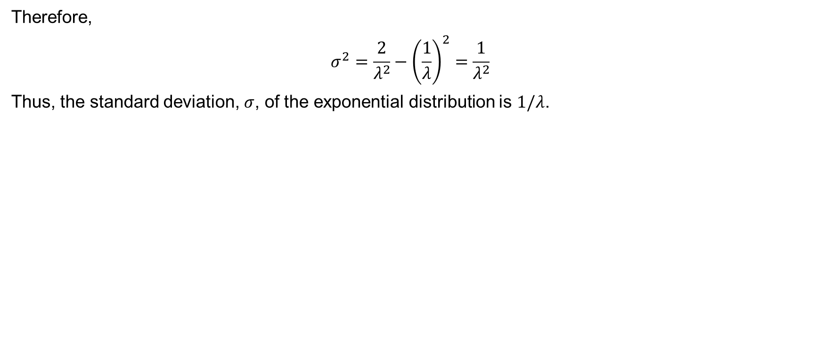
Variance for the exponential distribution (continued)
Therefore,
$$σ^{2}=\frac{2}{λ^{2}}−{\left(\frac{1}{λ}\right)}^{2}=\frac{1}{λ^{2}}$$
Thus, the standard deviation, $σ$, of the exponential distribution is $1/λ$.

Slide 24
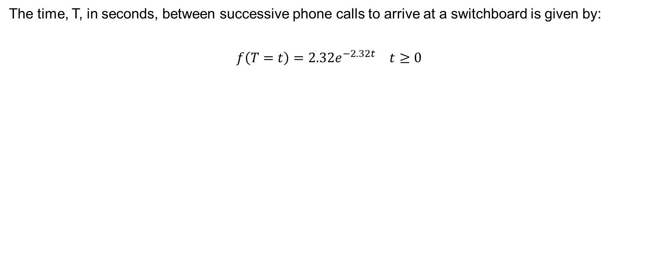
Worked example (Question 8 in the exercise sheet)
The time, T, in seconds, between successive phone calls to arrive at a switchboard is given by:
$$\begin{matrix}f\left(T=t\right)=2.32e^{−2.32t} & t≥0\end{matrix}$$

Slide 25
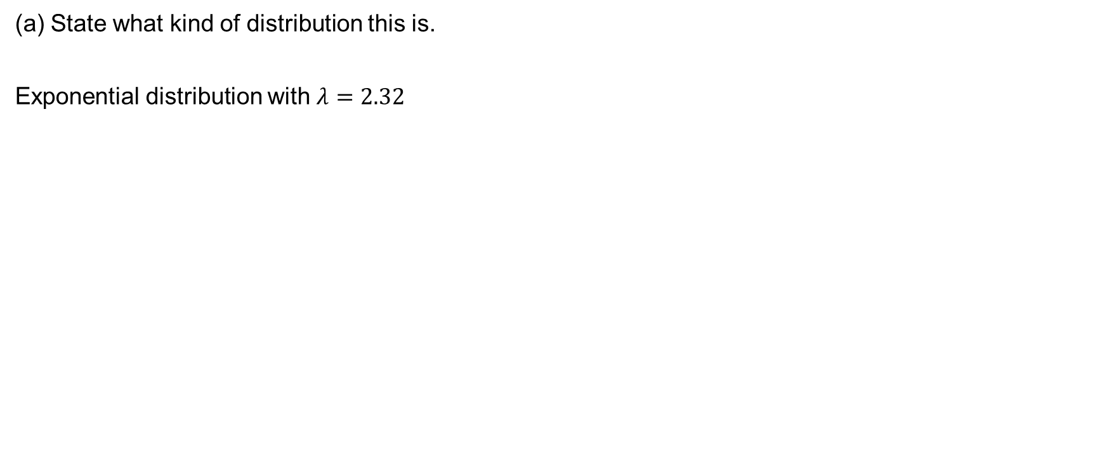
Worked example (continued)
(a) State what kind of distribution this is.
Exponential distribution with $λ=2.32$

Slide 26
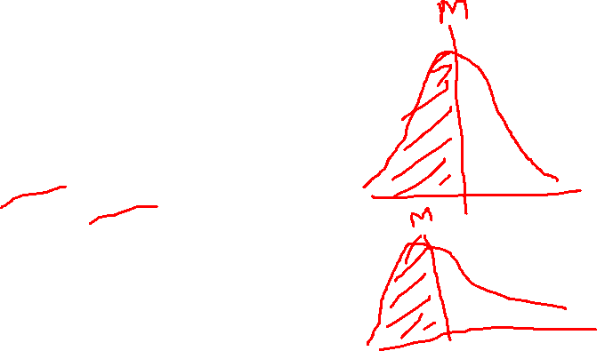
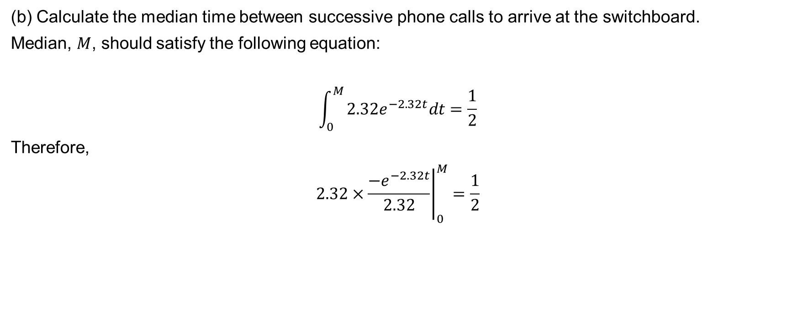


Worked example (continued)
(b) Calculate the median time between successive phone calls to arrive at the switchboard.
Median, $M$, should satisfy the following equation:
$$\int_{0}^{M}{2.32e^{−2.32t}dt=\frac{1}{2}}$$
Therefore,
$$2.32×{\left.\frac{{−e}^{−2.32t}}{2.32}\right|}_{0}^{M}=\frac{1}{2}$$

Slide 27
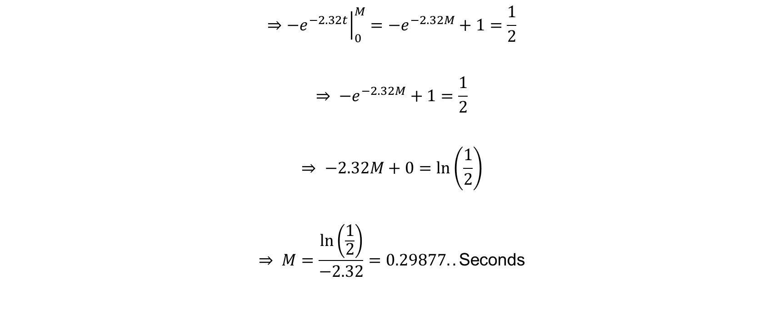
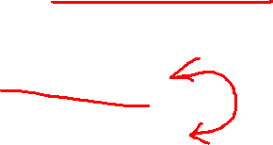
Worked example (continued)
$$⇒{\left.{−e}^{−2.32t}\right|}_{0}^{M}={−e}^{−2.32M}+1=\frac{1}{2}$$
$$⇒ −e^{−2.32M}+1=\frac{1}{2}$$
$$⇒ −2.32M+0=\ln\left(\frac{1}{2}\right)$$
$$⇒ M=\frac{\ln\left(\frac{1}{2}\right)}{−2.32}=0.29877..\text{Seconds}$$

Slide 28
Next time
Normal distribution

